Slide 1
12 Great Accomplishments
Michal Mních 7.A

Slide 2
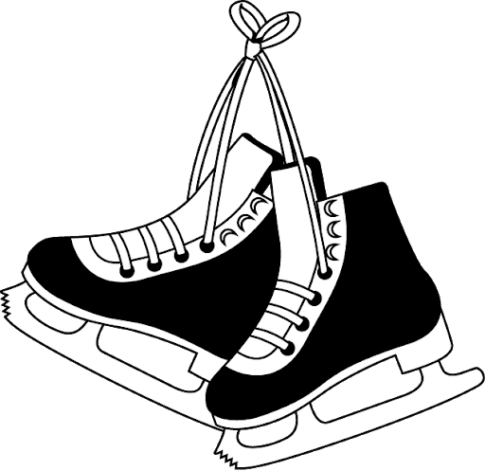
My Accomplishments
- I have gotten 1st place in a skiing competition
- I have gotten 1st place in an English competition
- I haven‘t broken any bone yet
- I have learnt how to skate on ice

Slide 3
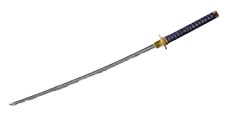
Matuš‘ Accomplishments
He has learnt how to cook
He has learnt how to fight with a sword
He has learnt how to speak English
He has learnt how to ride a bike

Slide 4
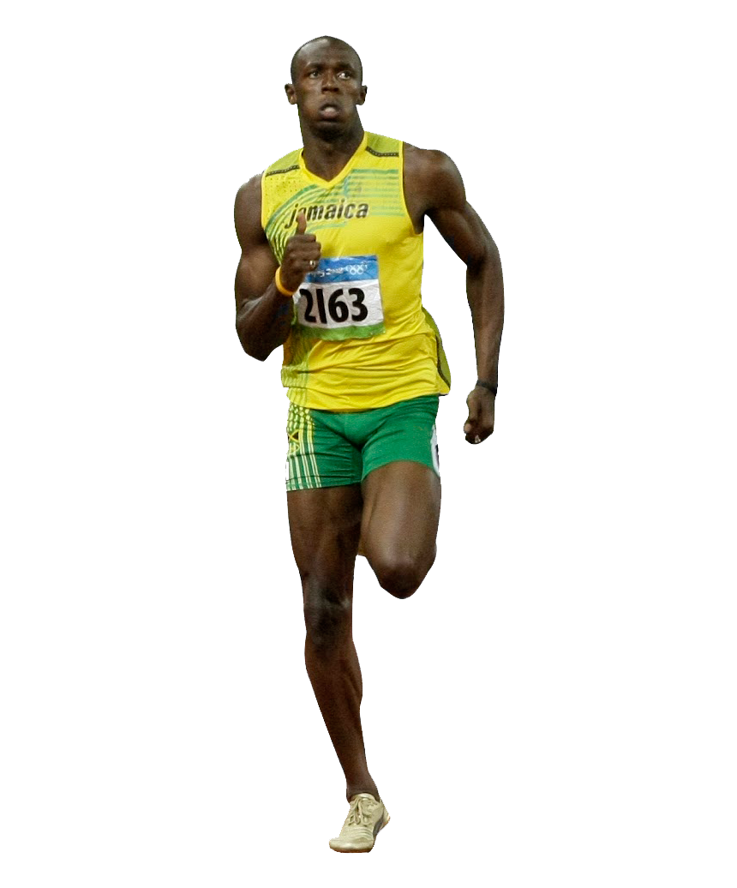
Usain Bolt‘s Accomplishments
He is known as the fastest man alive
He has won 9 Olympic gold medals
He has ran the men‘s 100 meter race in 9.63 seconds
He was the first man in Olympic history to win both the 100 meter and 200 meter races in world record times

